Slide 1
CHP 2 MESSAGE PASSING SYSTEM

Slide 2
IPC
Key Objectives of IPC:
Data Sharing: Facilitate the exchange of information between processes.
Resource Sharing: Allow processes to access shared resources like memory, files, or devices without conflicts.
Synchronization: Ensure processes execute in a coordinated manner, avoiding race conditions and deadlocks.
Communication: Enable processes to send and receive messages or signals.
Modularity: Support system and application design by allowing components to work independently and interact as needed.
Examples of IPC Mechanisms:
Pipes (e.g., unnamed and named pipes)
Message Queues
Shared Memory
Sockets
Signals
Semaphores

Slide 3
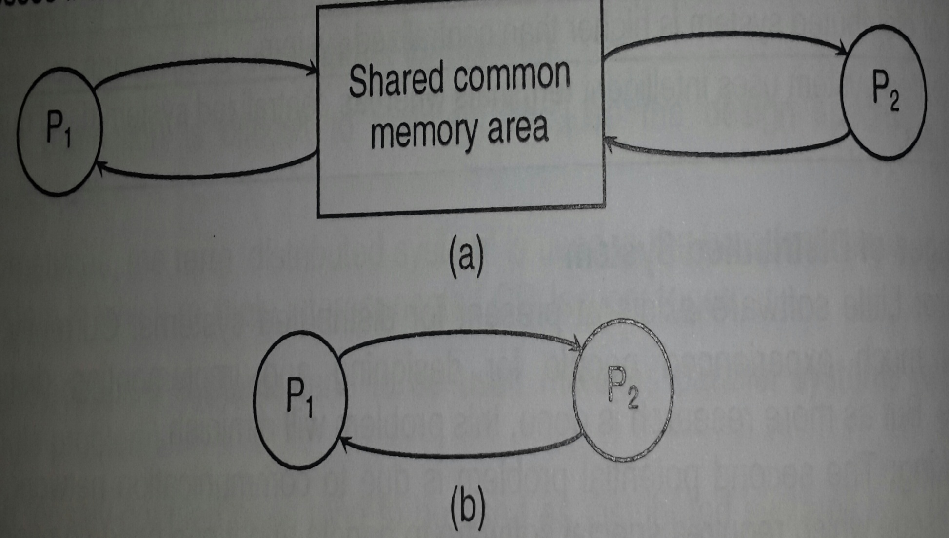
Techniques of Message Passing System
Original Sharing
Copy Sharing

Slide 4
Desirable Features of message Passing System
Simple
Uniform Semantics
Efficient
Portable
Correctness

Slide 5
Synchronization
Blocking (Synchronous)
Non-Blocking (Asynchronous)

Slide 6
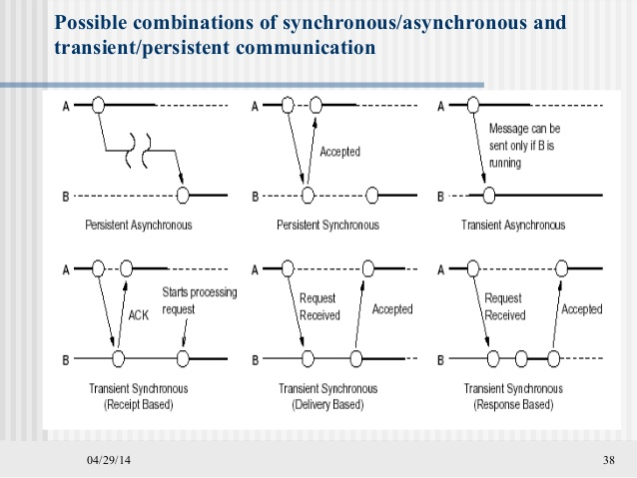
Persistent and Transient Communication

Slide 7
Client-Server is ideal for scenarios requiring centralized control, reliability, and security, such as e-commerce platforms or web services.
Peer-to-Peer is better suited for applications where scalability, fault tolerance, and resource sharing are prioritized, such as file-sharing networks or distributed computing systems.
Aspect | Client-Server | Peer-to-Peer (P2P)
Definition | A centralized model where a server provides resources or services to multiple clients. | A decentralized model where each node (peer) acts as both a client and a server.
Structure | Centralized: A single server or a group of servers manage the resources and requests. | Decentralized: Peers communicate directly without a central authority.
Scalability | Limited scalability; increasing clients may overload the server. | Highly scalable; adding more peers can increase capacity.
Performance | Server-dependent; performance may degrade if the server is overloaded. | Performance improves with more peers, but relies on peer availability.
Cost | Higher cost due to server maintenance and infrastructure. | Lower cost as resources are distributed among peers.
Reliability | Single point of failure; if the server goes down, the entire system can fail. | More reliable; the failure of one peer doesn’t affect the entire network.
Data Distribution | Centralized control; the server stores and manages data. | Distributed control; data is shared among peers.
Security | Easier to secure since data is centralized, but vulnerable to server attacks. | Harder to secure due to distributed nature and lack of central control.
Examples | - Web applications (e.g., websites, online banking) - Email services | - File-sharing systems (e.g., BitTorrent) - Blockchain networks

Slide 8
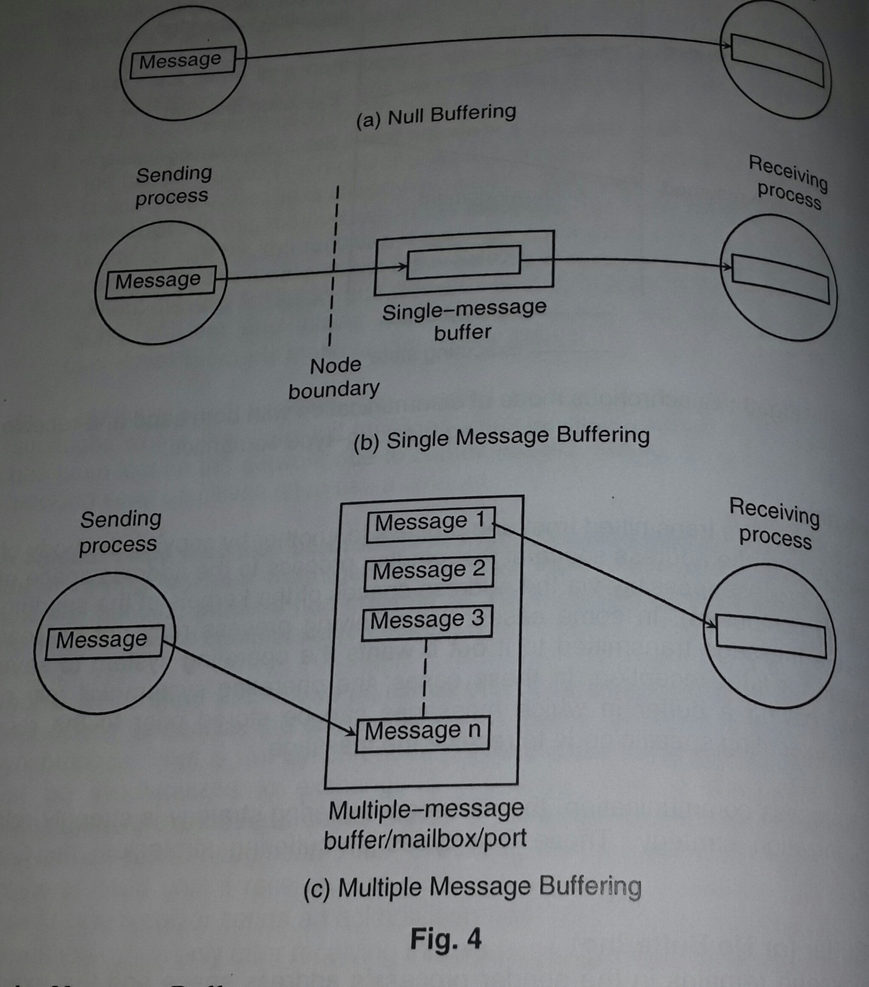
Buffering

Slide 9
Process Addressing
Explicit
Implicit
Send(process id, message)
Receive(process id, message)
Send(service id, message)
Receive(process id, message)

Slide 10
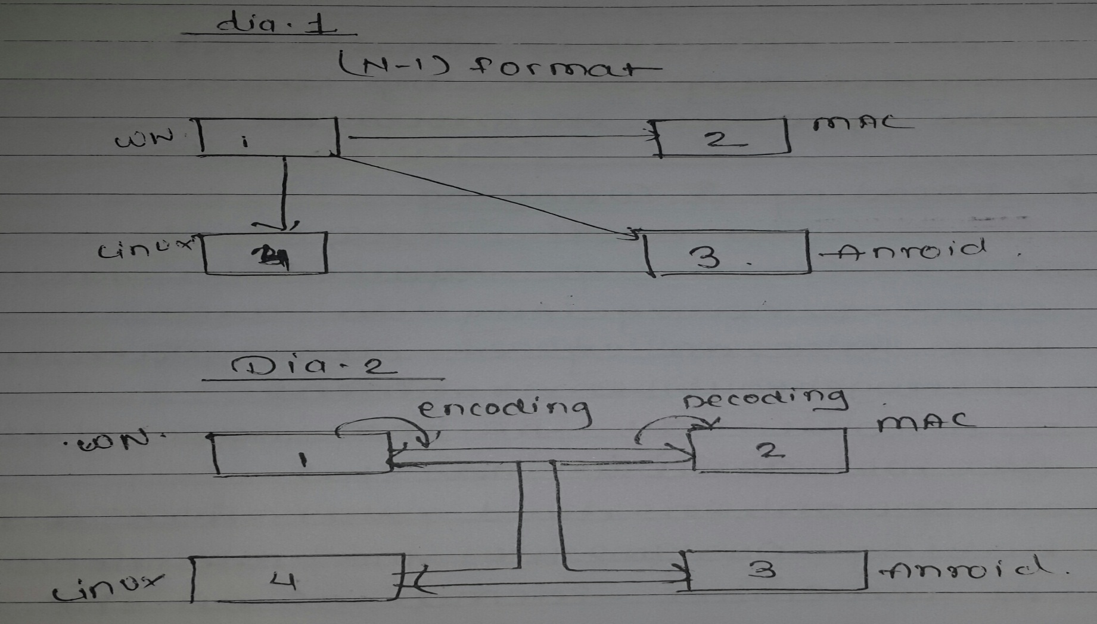
Encoding and Decoding

Slide 11
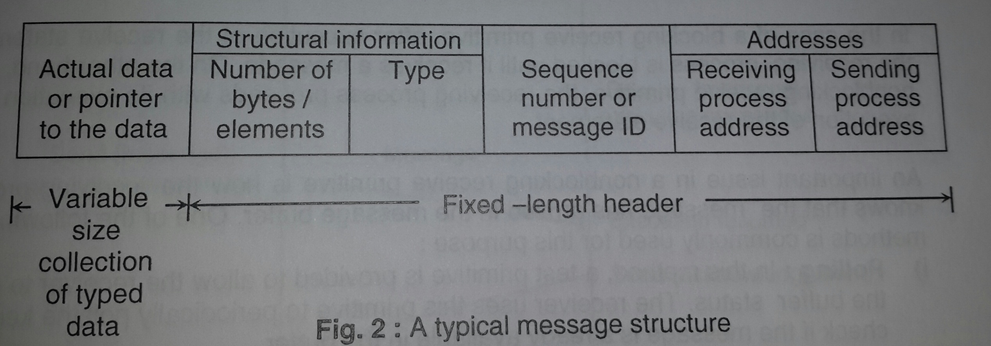
Message Format

Slide 12
Failures
Lost Request
Lost Reply
Server Crash

Slide 13
Solution
Four Way
Three Way
Two Way
Handling Duplicate Packets

Slide 14
Group Communication
1-M one to many
M-M many to many
M-1many to one

Slide 15
Ordering (Self Study)
Absolute
Consistent
Causal

Slide 16
THANK YOU !!!!

